Slide 1
Object oriented analysis & design
CS3C015

Slide 2
UNIT- 2
Models, Concepts in UML, Structural and Behavioral Models, Use Cases and functional Requirements, Use Case Descriptions, Classes, Relationships, Association, Generalization, Realization, Dependencies, Constraints

Slide 3
What is Modeling
Modeling consists of building an abstraction of reality.
Abstractions are simplifications because:
They ignore irrelevant details.
They only represent the relevant details.
What is relevant or irrelevant depends on the purpose of the model.

Slide 4
What is Model
A model is a simplification of reality.
A model may provide
blueprints of a system
Organization of the system
Dynamic of the system

Slide 5
Model
A model is an abstraction, before building any system a prototype may be developed. The main purpose of model is for understanding of the system.
Designer build different kinds of models for various purposes before constructing things.
For example car , airplane, blueprints of machine parts, Plan for house construction etc., Models serve many purposes

Slide 6

models

Slide 7
Importance of Modeling
Models help us
to visualize a system as it is or as we want it to be.
to specify the structure or behavior of a system.
in providing a template that guides us in constructing a system.
in providing documenting the decisions we have made.

Slide 8
Purpose of Modeling
Designers build many kinds of models for various purposes before constructing things.
Models serve several purposes –
Testing a physical entity before building (simulation)
Communication with customer
Visualization
Reduction of complexity
Better understanding of the problem

Slide 9
Purpose of Modeling
2. Communication with customers
Architects and product designers build models to show their customers. Mock ups are demonstration products that imitate some or all of the external behavior of a system.

Slide 10
Purpose of Modeling
3. Visualization
Storyboards of movies, television shows and advertisements let writers see how their ideas flow. They can modify awkward transitions, and unnecessary segments before detailed writing begins.

Slide 11
Purpose of Modeling
4. Reduction of complexity
The main reason for modeling is to deal with systems that are too complex to understand directly. Models reduce complexity by separating out a small number of important things to deal with at a time

Slide 13
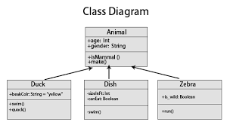
Class model
The class model shows all the classes present in the system. The class model shows the attributes and the behavior associated with the objects. The class diagram is used to show the class of the class.

Slide 14
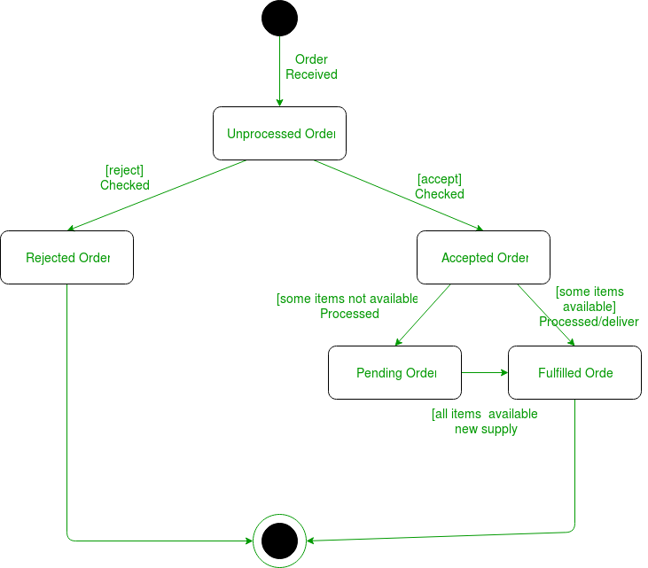
State model
State model describes those aspects of objects concerned with time and the sequencing of operations – events that mark changes, states that define the context for events, and the organization of events and states.

Slide 15
Interaction model
Interaction model is used to show the various interactions between objects, how the objects collaborate to achieve the behavior of the system as a whole. The following diagrams are used to show the interaction model:
Use Case Diagram
Sequence Diagram
Activity Diagram

Slide 16
Systems and Models in UML
System − A set of elements organized to achieve certain objectives form a system. Systems are often divided into subsystems and described by a set of models.
Model − Model is a simplified, complete, and consistent abstraction of a system, created for better understanding of the system.
View − A view is a projection of a system’s model from a specific perspective.

Slide 17
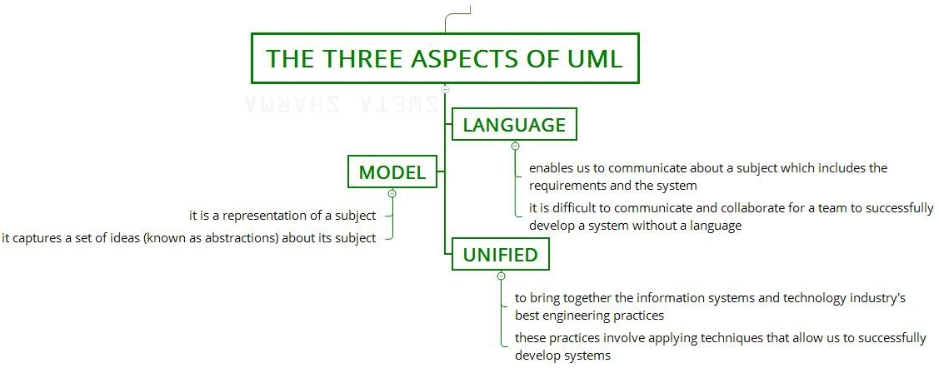

Slide 18
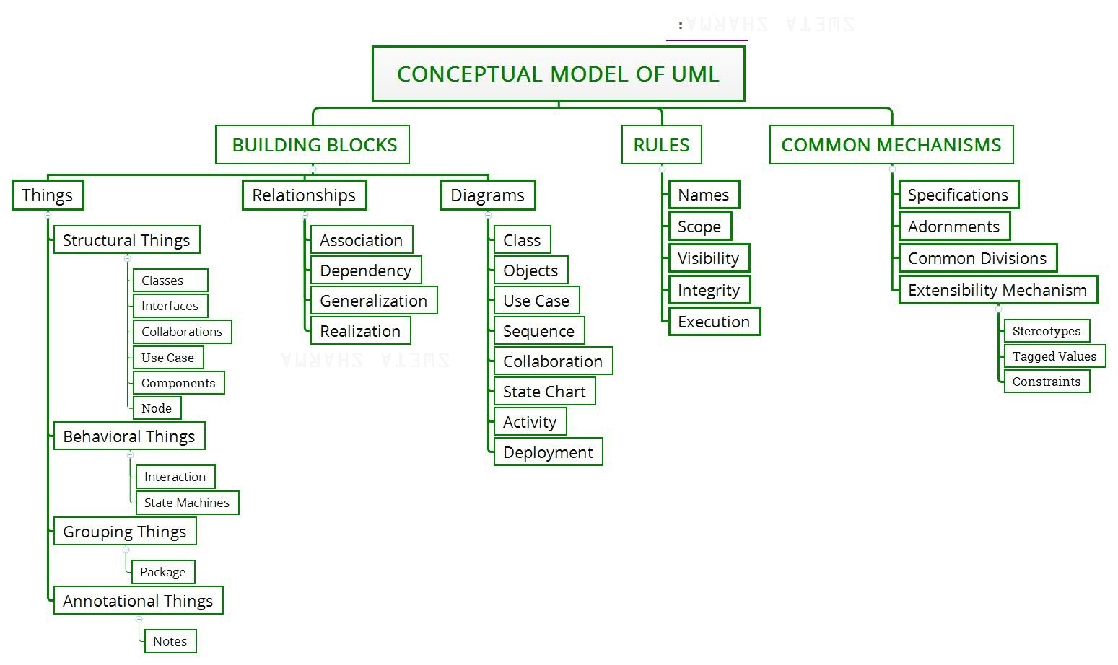

Slide 19
Conceptual Model of UML
The Conceptual Model of UML encompasses three major elements −
Basic building blocks
Rules
Common mechanisms

Slide 20
Basic Building Blocks
The three building blocks of UML are −
Things
Relationships
Diagrams

Slide 21
Basic Building Blocks
1. Things
There are four kinds of things in UML, namely −
Structural Things − These are the nouns of the UML models representing the static elements that may be either physical or conceptual. The structural things are class, interface, collaboration, use case, active class, components, and nodes.
Behavioral Things − These are the verbs of the UML models representing the dynamic behavior over time and space. The two types of behavioral things are interaction and state machine.
Grouping Things − They comprise the organizational parts of the UML models. There is only one kind of grouping thing, i.e., package.
Annotational Things − These are the explanations in the UML models representing the comments applied to describe elements.

Slide 22
Basic Building Blocks
The three building blocks of UML are −
Things
Relationships
Diagrams

Slide 23
Basic Building Blocks
2. Relationships
Relationships are the connection between things. The four types of relationships that can be represented in UML are −
Dependency − This is a semantic relationship between two things such that a change in one thing brings a change in the other. The former is the independent thing, while the latter is the dependent thing.
Association − This is a structural relationship that represents a group of links having common structure and common behavior.
Generalization − This represents a generalization/specialization relationship in which subclasses inherit structure and behavior from super-classes.
Realization − This is a semantic relationship between two or more classifiers such that one classifier lays down a contract that the other classifiers ensure to abide by.

Slide 24
Basic Building Blocks
The three building blocks of UML are −
Things
Relationships
Diagrams

Slide 25
Basic Building Blocks
3. Diagrams
A diagram is a graphical representation of a system. It comprises of a group of elements generally in the form of a graph. UML includes nine diagrams in all, namely −
Class Diagram
Object Diagram
Use Case Diagram
Sequence Diagram
Collaboration Diagram
State Chart Diagram
Activity Diagram
Component Diagram
Deployment Diagram

Slide 26
Conceptual Model of UML
The Conceptual Model of UML encompasses three major elements −
Basic building blocks
Rules
Common mechanisms

Slide 28
rules
UML has a number of rules so that the models are semantically self-consistent and related to other models in the system harmoniously. UML has semantic rules for the following −
Name: Name of relationship, things, and diagrams.
Visibility: How these names will be seen and used by others.
Scope: Scope can be defined as an aspect that gives a definite meaning to a name.
Integrity: Integrity is used to measure how things are associated with each other.
Execution: It means to simulate the dynamic model.

Slide 30
Conceptual Model of UML
The Conceptual Model of UML encompasses three major elements −
Basic building blocks
Rules
Common mechanisms

Slide 31
Common mechanisms
UML has four common mechanisms −
Specifications:- behind each graphical notation, there is a textual statement denoting the syntax and semantics. These are the specifications. The specifications provide a semantic backplane that contains all the parts of a system and the relationship among the different paths.
Adornments:- Each element in UML has a unique graphical notation. Besides, there are notations to represent the important aspects of an element like name, scope, visibility, etc.

Slide 32
Common mechanisms
3. Common Divisions:- Object-oriented systems can be divided in many ways. The two common ways of division are −
Division of classes and objects −
Division of Interface and Implementation .
4. Extensibility Mechanisms:-
Stereotypes − It extends the vocabulary of the UML, through which new building blocks can be created out of existing ones.
Tagged Values − It extends the properties of UML building blocks.
Constraints − It extends the semantics of UML building blocks.

Slide 33
Three ways to apply UML:
UML as sketch: Informal and incomplete diagrams created to explore difficult parts of the problem.
UML as blueprint: Detailed design diagram used for better understanding of code.
UML as programming language: Complete executable specification of a software system in UML.

Slide 34
Three perspectives to apply UML:
Conceptual perspective: Diagrams describe the things of real world.
Specification perspective: Diagrams describe software abstractions or components with specifications and interfaces.
Implementation perspective: Diagrams describe software implementation in a particular technology

Slide 35
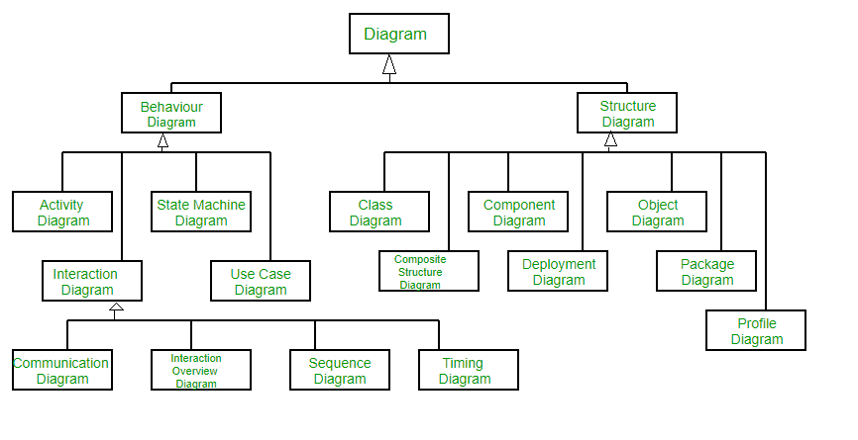
Structural and Behavioral Models

Slide 36
Structural and Behavioral Models
Structural Diagrams – Capture static aspects or structure of a system. Structural Diagrams include: Component Diagrams, Object Diagrams, Class Diagrams and Deployment Diagrams.
Behavior Diagrams – Capture dynamic aspects or behavior of the system. Behavior diagrams include: Use Case Diagrams, State Diagrams, Activity Diagrams and Interaction Diagrams

Slide 37
Structural Diagrams
1. Class Diagram – The most widely use UML diagram is the class diagram. It is the building block of all object oriented software systems. We use class diagrams to depict the static structure of a system by showing system’s classes, their methods and attributes. Class diagrams also help us identify relationship between different classes or objects.

Slide 38
Structural Diagrams
2. Composite Structure Diagram – We use composite structure diagrams to represent the internal structure of a class and its interaction points with other parts of the system. A composite structure diagram represents relationship between parts and their configuration which determine how the classifier (class, a component, or a deployment node) behaves. They represent internal structure of a structured classifier making the use of parts, ports, and connectors. We can also model collaborations using composite structure diagrams. They are similar to class diagrams except they represent individual parts in detail as compared to the entire class.

Slide 39
Structural Diagrams
3. Object Diagram – An Object Diagram can be referred to as a screenshot of the instances in a system and the relationship that exists between them. Since object diagrams depict behaviour when objects have been instantiated, we are able to study the behaviour of the system at a particular instant. An object diagram is similar to a class diagram except it shows the instances of classes in the system. We depict actual classifiers and their relationships making the use of class diagrams. On the other hand, an Object Diagram represents specific instances of classes and relationships between them at a point of time.

Slide 40
Structural Diagrams
4. Component Diagram – Component diagrams are used to represent the how the physical components in a system have been organized. We use them for modelling implementation details. Component Diagrams depict the structural relationship between software system elements and help us in understanding if functional requirements have been covered by planned development. Component Diagrams become essential to use when we design and build complex systems. Interfaces are used by components of the system to communicate with each other.

Slide 41
Structural Diagrams
5. Deployment Diagram – Deployment Diagrams are used to represent system hardware and its software.It tells us what hardware components exist and what software components run on them.We illustrate system architecture as distribution of software artifacts over distributed targets. An artifact is the information that is generated by system software. They are primarily used when a software is being used, distributed or deployed over multiple machines with different configurations.

Slide 42
Structural Diagrams
6. Package Diagram – We use Package Diagrams to depict how packages and their elements have been organized. A package diagram simply shows us the dependencies between different packages and internal composition of packages. Packages help us to organise UML diagrams into meaningful groups and make the diagram easy to understand. They are primarily used to organise class and use case diagrams.

Slide 43
Behavior Diagrams –
1. State Machine Diagrams – A state diagram is used to represent the condition of the system or part of the system at finite instances of time. It’s a behavioral diagram and it represents the behavior using finite state transitions. State diagrams are also referred to as State machines and State-chart Diagrams . These terms are often used interchangeably. So simply, a state diagram is used to model the dynamic behavior of a class in response to time and changing external stimuli.

Slide 44
Behavior Diagrams –
2. Activity Diagrams – We use Activity Diagrams to illustrate the flow of control in a system. We can also use an activity diagram to refer to the steps involved in the execution of a use case. We model sequential and concurrent activities using activity diagrams. So, we basically depict workflows visually using an activity diagram. An activity diagram focuses on condition of flow and the sequence in which it happens. We describe or depict what causes a particular event using an activity diagram.

Slide 45
Behavior Diagrams –
3. Use Case Diagrams – Use Case Diagrams are used to depict the functionality of a system or a part of a system. They are widely used to illustrate the functional requirements of the system and its interaction with external agents(actors). A use case is basically a diagram representing different scenarios where the system can be used. A use case diagram gives us a high level view of what the system or a part of the system does without going into implementation details.

Slide 46
Behavior Diagrams –
4. Sequence Diagram – A sequence diagram simply depicts interaction between objects in a sequential order i.e. the order in which these interactions take place.We can also use the terms event diagrams or event scenarios to refer to a sequence diagram. Sequence diagrams describe how and in what order the objects in a system function. These diagrams are widely used by businessmen and software developers to document and understand requirements for new and existing systems.

Slide 47
Behavior Diagrams –
5. Communication Diagram – A Communication Diagram(known as Collaboration Diagram in UML 1.x) is used to show sequenced messages exchanged between objects. A communication diagram focuses primarily on objects and their relationships. We can represent similar information using Sequence diagrams, however, communication diagrams represent objects and links in a free form.

Slide 48
Behavior Diagrams –
6. Timing Diagram – Timing Diagram are a special form of Sequence diagrams which are used to depict the behavior of objects over a time frame. We use them to show time and duration constraints which govern changes in states and behavior of objects.

Slide 49
Behavior Diagrams –
7. Interaction Overview Diagram – An Interaction Overview Diagram models a sequence of actions and helps us simplify complex interactions into simpler occurrences. It is a mixture of activity and sequence diagrams.

Slide 50
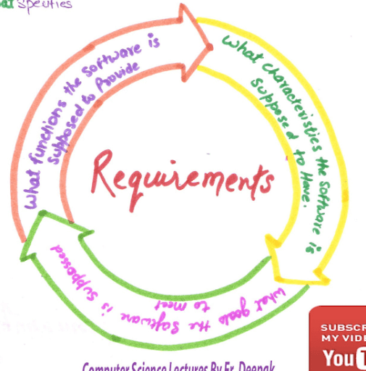
requirement
Requirement is a feature of the system or description of something the system is capable of doing in order to fulfill the system’s purpose.

Slide 51
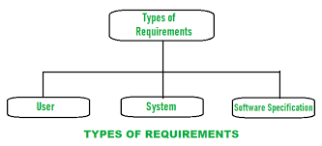
Types of requirement

Slide 52
Types of requirement
1. user requirement:- collection of statement in natural language(customer).
2. system requirement: it is a structured document that gives the detailed description of the system services.(GUI)
3. software specification: it is detailed software description that can serve as a basis for design.(s/w developer)

Slide 53
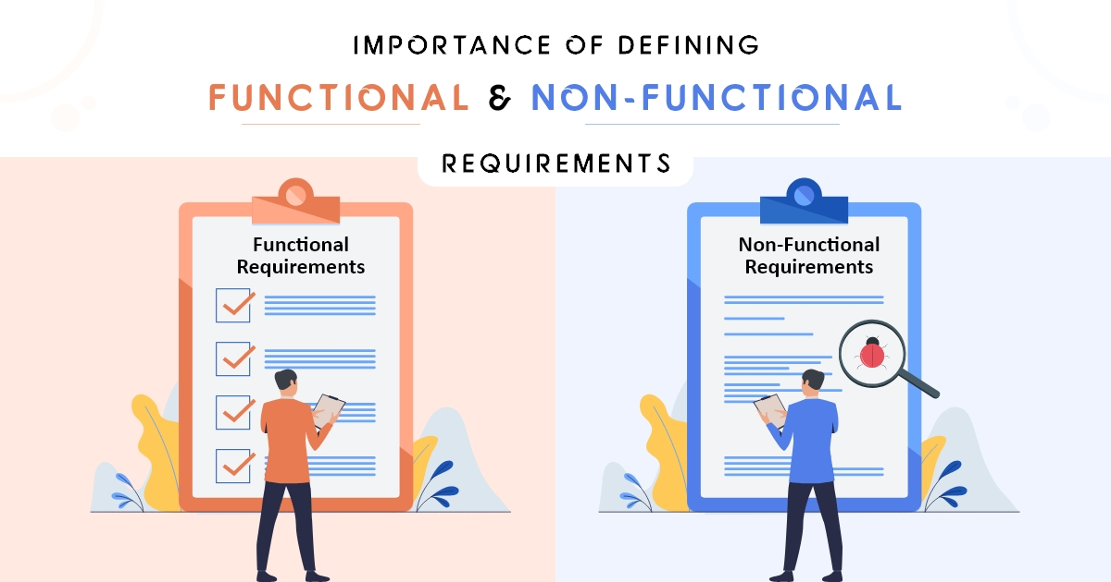
FUNCTIONAL AND NON FUNCTIONAL REQ.

Slide 54
FUNCTIONAL REQUIREMENTS:
These are the requirements that the end user specifically demands as basic facilities that the system should offer. All these functionalities need to be necessarily incorporated into the system as a part of the contract. These are represented or stated in the form of input to be given to the system, the operation performed and the output expected. They are basically the requirements stated by the user which one can see directly in the final product, unlike the non-functional requirements.

Slide 55
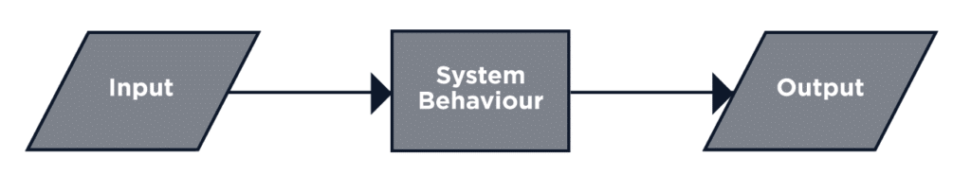
FUNCTIONAL REQUIREMENTS:
Example
Login
View
Update
Issue
Return
manage Student info

Slide 56
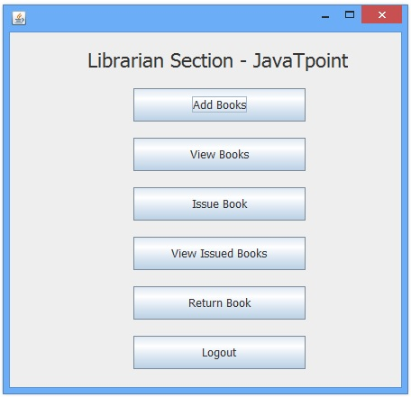

Slide 57
NON FUNCTIONAL REQUIREMENTS:
These are basically the quality constraints that the system must satisfy according to the project contract. The priority or extent to which these factors are implemented varies from one project to other. They are also called non-behavioral requirements.

Slide 58
NON FUNCTIONAL REQUIREMENTS:
Availability
Reliability
portability
Maintainability
Efficiency
Scalability
Usability
Interoperability
Notes:
58

Slide 59
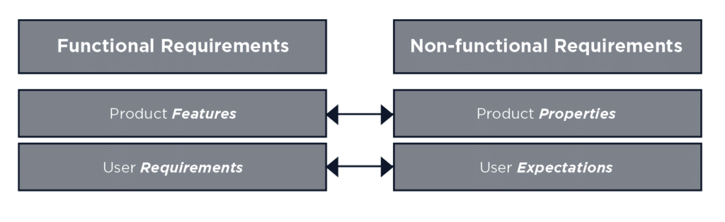
FUNCTIONAL AND NON FUNCTIONAL REQUIREMENTS:

Slide 60
EXAMPLE
Functional Requirements
Authentication of a user when he/she tries to log into the system.
System shutdown in the case of a cyber attack.
Verification email is sent to user whenever he/she registers for the first time on some software system.
Non-functional Requirements
Emails should be sent with a latency of no greater than 12 hours.
Each request should be processed within 10 seconds.
The site should load in 3 seconds when the number of simultaneous users are > 10000

Slide 61
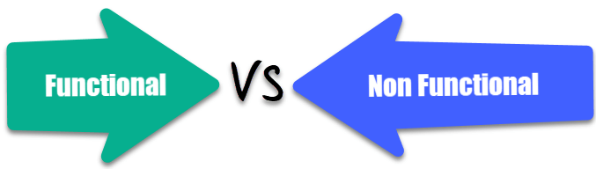
DIFFERENCE

Slide 62
Parameters | Functional Requirement | Non-Functional Requirement
What it is | Verb | Attributes
Requirement | It is mandatory | It is non-mandatory
Capturing type | It is captured in use case. | It is captured as a quality attribute.
End-result | Product feature | Product properties
Capturing | Easy to capture | Hard to capture
Objective | Helps you verify the functionality of the software. | Helps you to verify the performance of the software.
Area of focus | Focus on user requirement | Concentrates on the user's expectation.
Documentation | Describe what the product does | Describes how the product works
Type of Testing | Functional Testing like System, Integration, End to End, API testing, etc. | Non-Functional Testing like Performance, Stress, Usability, Security testing, etc.
Test Execution | Test Execution is done before non-functional testing. | After the functional testing
Product Info | Product Features | Product Properties

Slide 63
Use case diagram
Use Case Diagram captures the system’s functionality and requirements by using actors and use cases. Use Cases model the services, tasks, function that a system needs to perform. Use cases represent high-level functionalities and how a user will handle the system. Use-cases are the core concepts of Unified Modelling language modeling.

Slide 64
Use case diagram
Why:-
It models how an external entity interacts with the system to make it work. Use case diagrams are responsible for visualizing the external things that interact with the part of the system.

Slide 65
Importance of Use Case Diagrams
To identify functions and how roles interact with them – The primary purpose of use case diagrams.
For a high-level view of the system – Especially useful when presenting to managers or stakeholders. We can highlight the roles that interact with the system and the functionality provided by the system without going deep into inner workings of the system.
To identify internal and external factors – This might sound simple but in large complex projects a system can be identified as an external role in another use case.

Slide 66

Use case diagram notations
Use-case: Use cases are used to represent high-level functionalities and how the user will handle the system. A use case represents a distinct functionality of a system, a component, a package, or a class. It is denoted by an oval shape with the name of a use case written inside the oval shape.

Slide 67

Use case diagram
Actor: It is used inside use case diagrams. The actor is an entity that interacts with the system. A user is the best example of an actor. An actor is an entity that initiates the use case from outside the scope of a use case. It can be any element that can trigger an interaction with the use case. One actor can be associated with multiple use cases in the system.

Slide 68
USE CASE DIAGRAM
Association:
communication between an actor and a use case; Represented by a solid line.
Generalization: relationship between one general use case and a special use case (used for defining special alternatives) Represented by a line with a triangular arrow head toward the parent use case.

Slide 69

Use case diagram
Relationships Illustrate relationships between an actor and a use case with a simple line. For relationships among use cases, use arrows labeled either “include" or "extends." A "uses" relationship indicates that one use case is needed by another in order to perform a task. An "extends" relationship indicates alternative options under a certain use case.

Slide 70
USE CASE DIAGRAM
Include: a dotted line labeled <<include>> beginning at base use case and ending with an arrows pointing to the include use case. The include relationship occurs when a chunk of behavior is similar across more than one use case. Use “include” in stead of copying the description of that behavior.
<<include>>
Extend: a dotted line labeled <<extend>> with an arrow toward the base case. The extending use case may add behavior to the base use case. The base class declares “extension points”.
<<extend>>
Notes:
70

Slide 71
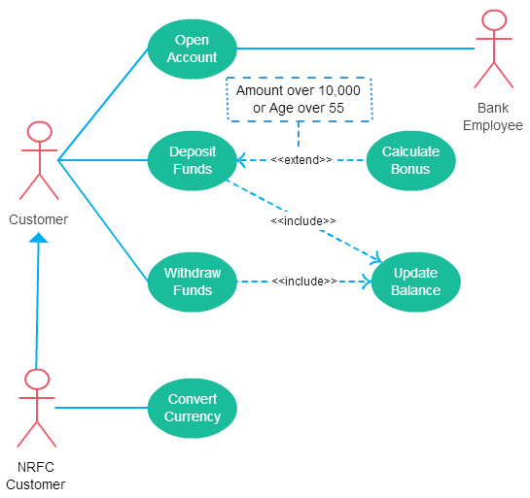

Slide 72

Use case diagram
System Draw your system's boundaries using a rectangle that contains use cases. Place actors outside the system's boundaries.

Slide 73
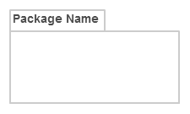
Package:- The package is another optional element that is extremely useful in complex diagrams. Similar to class diagrams, packages are used to group together use cases. They are drawn like the image shown below.

Slide 74
Use case diagram rules
The name of an actor or a use case must be meaningful and relevant to the system.
Interaction of an actor with the use case must be defined clearly and in an understandable way.
Annotations must be used wherever they are required.
If a use case or an actor has multiple relationships, then only significant interactions must be displayed.

Slide 75
Use case diagram: tips
A use case diagram should be as simple as possible.
A use case diagram should be complete.
A use case diagram should represent all interactions with the use case.
If there are too many use cases or actors, then only the essential use cases should be represented.
A use case diagram should describe at least a single module of a system.
If the use case diagram is large, then it should be generalized.
.

Slide 76
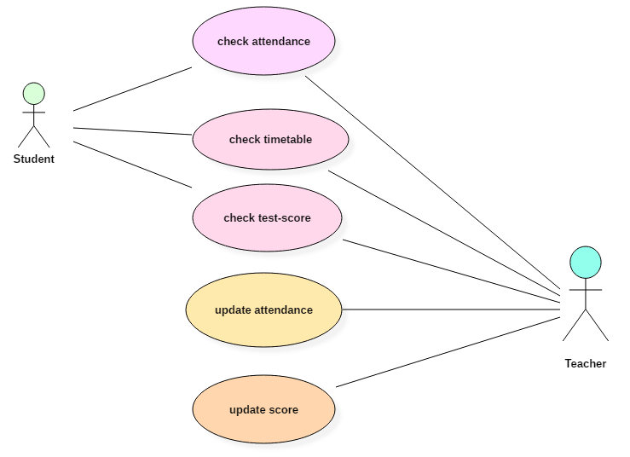
USE CASE DIAGRAM

Slide 77
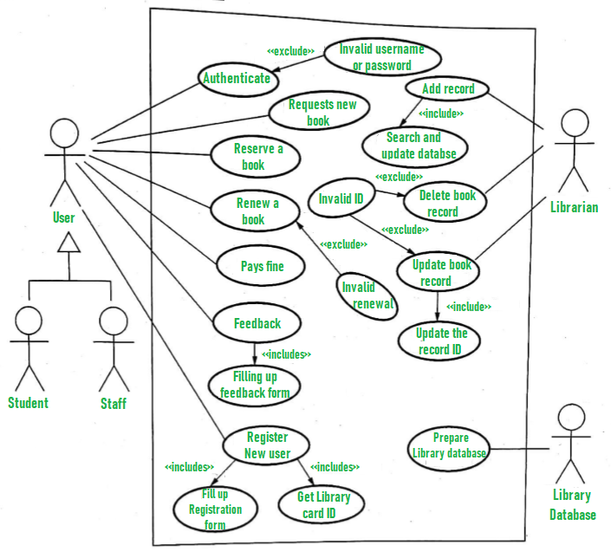
DATA FLOW DIAGRAM

Slide 78
CLASS DIAGRAM
The class diagram depicts a static view of an application. It represents the types of objects residing in the system and the relationships between them. A class consists of its objects, and also it may inherit from other classes. A class diagram is used to visualize, describe, document various different aspects of the system, and also construct executable software code.
It shows the attributes, classes, functions, and relationships to give an overview of the software system. It constitutes class names, attributes, and functions in a separate compartment that helps in software development.

Slide 79
CLASS DIAGRAM
Purpose
The main purpose of class diagrams is to build a static view of an application. It is the only diagram that is widely used for construction, and it can be mapped with object-oriented languages.

Slide 80
CLASS DIAGRAM
Uses:-
Describes the static view of the system
Shows the collaboration among the elements of the static view
Describes the functionalities performed by the system.
Construction of software applications using object oriented languages.

Slide 81
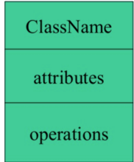
CLASS DIAGRAM
Essential elements of UML class diagram are:
Class Name
Attributes
Operations

Slide 82
CLASS DIAGRAM
Class Name:- The class is rendered as a rectangle, including its name, attributes, and operations in sperate compartments.
A class name should always start with a capital letter.
A class name should always be in the center of the first compartment.
A class name should always be written in bold format.
UML abstract class name should be written in italics format.
ClassName
attributes
operations

Slide 83
CLASS DIAGRAM
Attributes:
An attribute is named property of a class which describes the object being modeled. In the class diagram, this component is placed just below the name-compartment.
Person
name : String
address : Address
birthdate : Date
ssn : Id

Slide 84
Class Attributes (Cont’d)
Attributes are usually listed in the form:
attributeName : Type
A derived attribute is one that can be
computed from other attributes, but
doesn’t actually exist. For example,
a Person’s age can be computed from
his birth date. A derived attribute is
designated by a preceding ‘/’ as in:
/ age : Date
Person
name : String
address : Address
birthdate : Date
/ age : Date
ssn : Id

Slide 85
Class Attributes (Cont’d)
Person
Public, private, protected and package and derived are the five visibilities which are denoted by +, -, #, ~ and / signs respectively.
Visibility describes the accessibility of an attribute of a class.
Attributes can be:
+ public
# protected
- private
/ derived
+ name : String
# address : Address
# birthdate : Date
/ age : Date
- ssn : Id

Slide 86
CLASS DIAGRAM
ClassOperations (Methods/functions)
Operations are shown in the third partition. They are services the class provides.
The return type of a method is shown after the colon at the end of the method signature.
The return type of method parameters is shown after the colon following the parameter name.
Operations map onto class methods in code
Person
name : String
address : Address
birthdate : Date
ssn : Id
eat
sleep
work
play

Slide 87
Class Operations (Cont’d)
PhoneBook
newEntry (n : Name, a : Address, p : PhoneNumber, d : Description)
getPhone ( n : Name, a : Address) : PhoneNumber
You can specify an operation by stating its signature: listing the name, type, and default value of all parameters, and, in the case of functions, a return type.

Slide 88
Depicting Classes
When drawing a class, you needn’t show attributes and operation in every diagram.
Person
Person
Person
name : String
birthdate : Date
ssn : Id
Person
name
address
birthdate
eat()
sleep()
work()
play()
Person
eat
play

Slide 89
Class Responsibilities
A class may also include its responsibilities in a class diagram.
A responsibility is a contract or obligation of a class to perform a particular service.
SmokeAlarm
Responsibilities
-- sound alert and notify guard station
when smoke is detected.
-- indicate battery state

Slide 90
Class example
Name
Account_Name
- Customer_Name
- Balance
Attributes
+addFunds( )
+withDraw( )
+transfer( )
Operations

Slide 91
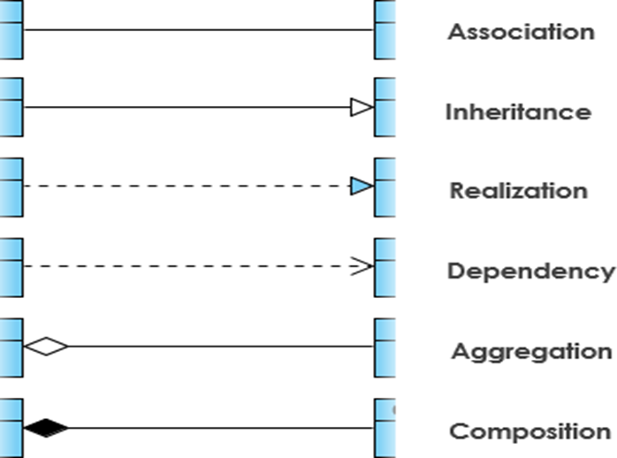
CLASS DIAGRAM
Relationships
In UML, relationships are of three types:
Dependency
Generalization
Association

Slide 92

CLASS DIAGRAM
Dependency: A dependency is a semantic relationship between two or more classes where a change in one class cause changes in another class.
It forms a weaker relationship. In the following example, Student_Name is dependent on the Student_Id.

Slide 93
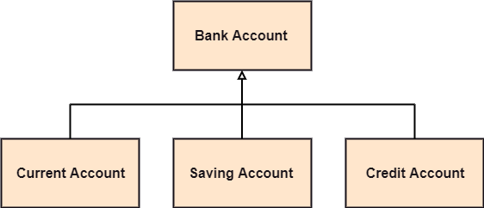
CLASS DIAGRAM
2. Generalization: A generalization is a relationship between a parent class (superclass) and a child class (subclass). In this, the child class is inherited from the parent class. For example, The Current Account, Saving Account, and Credit Account are the generalized form of Bank Account.

Slide 94
class: solid line, black arrow
abstract class: solid line, white arrow
interface: dashed line, white arrow

Slide 95

CLASS DIAGRAM
3. Association: It describes a static or physical connection between two or more objects. It depicts how many objects are there in the relationship. For example, a department is associated with the college.

Slide 96
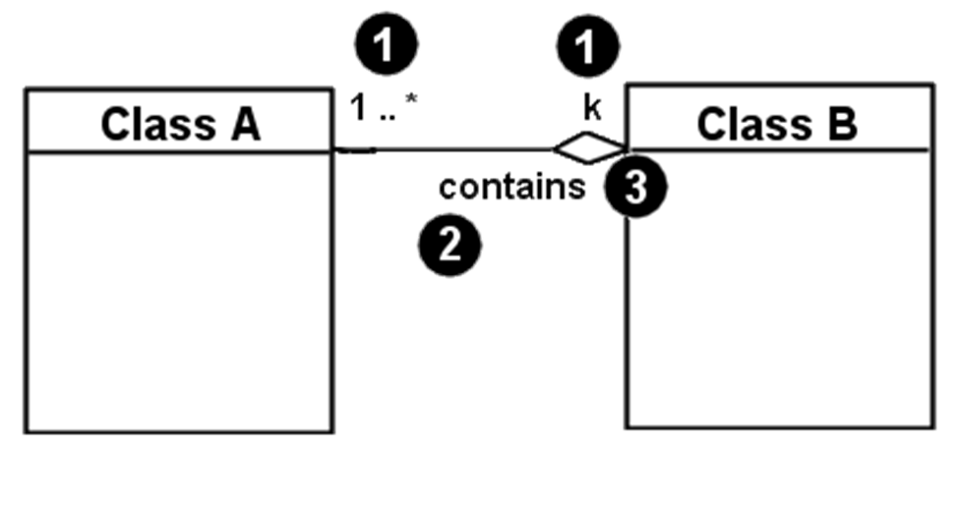
association
1. Multiplicity (how many are used)
2. Name (what relationship the objects have)
3. Navigability (direction)

Slide 97
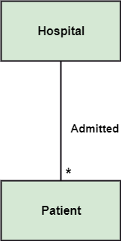
association
3.1 Multiplicity: It defines a specific range of allowable instances of attributes. In case if a range is not specified, one is considered as a default multiplicity.
Exactly one - 1
Zero or one - 0..1
Many - 0..* or *
One or more - 1..*
Exact Number - e.g. 3..4 or 6
Or a complex relationship - e.g. 0..1, 3..4, 6.* would mean any number of objects other than 2 or 5
For example, multiple patients are admitted to one hospital.

Slide 98

association
3.2 Association Name:- Associations may be named
The names should communicate the meaning of the links
The names are typically verb phases
The name should include an arrow indicating the direction in which the name should be read

Slide 99

We can also indicate the behavior of an object in an association (i.e., the role of an object) using rolenames.

Slide 100
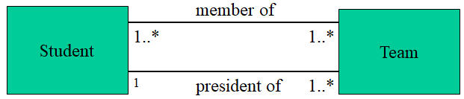
We can specify dual associations.

Slide 101
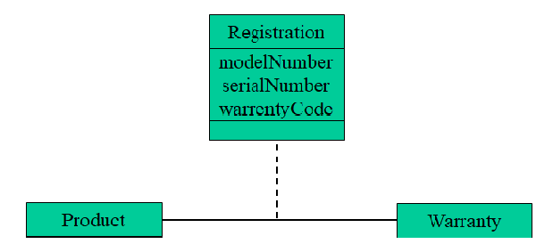
Associations can also be objects themselves, called link classes or an association classes

Slide 102
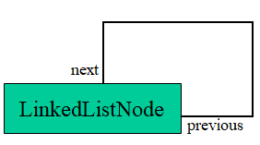
A class can have a self /recursive association.

Slide 103
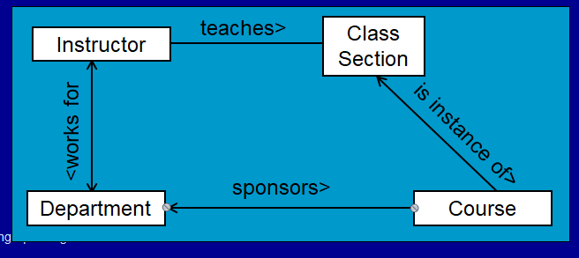
association
3.3 Navigation:- The navigation of associations can be
Uni -directional
bi-directional
unspecified

Slide 104
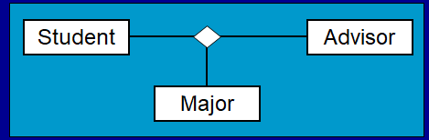
association
N-ary Associations can connect more than one class

Slide 105
Interface
An interface is a named set of operations that specifies the behavior of objects without showing their inner structure. It can be rendered in the model by a one- or two-compartment rectangle, with the stereotype <<interface>> above the interface name.
<<interface>>
ControlPanel

Slide 106
Interfaces do not get instantiated. They have no attributes or state. Rather, they specify the services offered by a related class.
<<interface>>
ControlPanel
getChoices : Choice[]
makeChoice (c : Choice)
getSelection : Selection

Slide 107
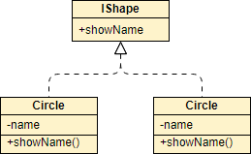
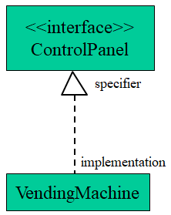
REALIZATION
One entity denotes some responsibility which is not implemented by itself and the other entity that implements them. This relationship is mostly found in the case of interfaces.

Slide 108

CLASS DIAGRAM
Aggregation: An aggregation is a subset of association, which represents has a relationship. It defines a part-whole or part-of relationship. In this kind of relationship, the parent class can exist independently of its child class.
The company encompasses a number of employees, and even if one employee resigns, the company still exists.

Slide 109
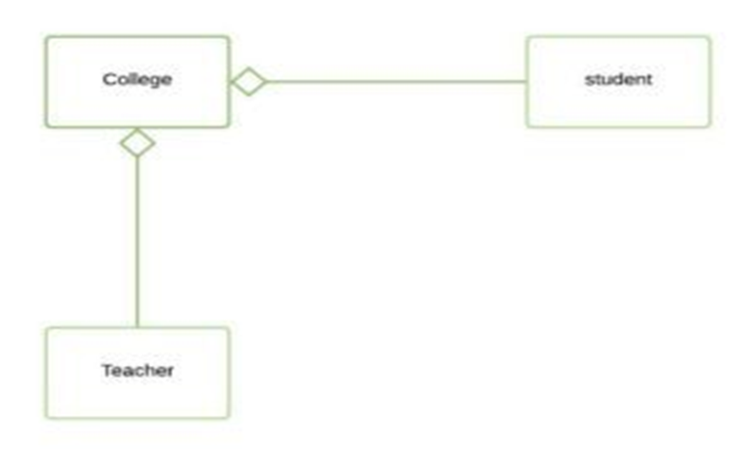
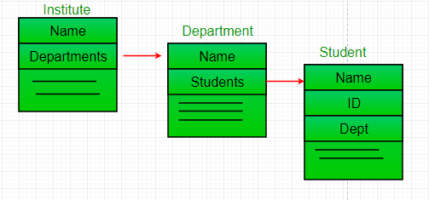
aggregation
It is a unidirectional association i.e. a one way relationship. For example, department can have students but vice versa is not possible and thus unidirectional in nature.

Slide 110

CLASS DIAGRAM
Composition: The composition is a subset of aggregation. It portrays the dependency between the parent and its child, which means if one part is deleted, then the other part also gets discarded. It represents a whole-part relationship.
A contact book consists of multiple contacts, and if you delete the contact book, all the contacts will be lost.

Slide 111

Composition
For example, if college is composed of classes student. The college could contain many students, while each student belongs to only one college. So, if college is not functioning all the students also removed.

Slide 112
AGGREGATION VS. COMPOSITION
Aggregation
Aggregation indicates a relationship where the child can exist separately from their parent class. Example: Automobile (Parent) and Car (Child). So, If you delete the Automobile, the child Car still exist.
Composition
Composition display relationship where the child will never exist independent of the parent. Example: House (parent) and Room (child). Rooms will never separate into a House.

Slide 113
HOW TO DRAW A CLASS DIAGRAM?
To describe a complete aspect of the system, it is suggested to give a meaningful name to the class diagram.
The objects and their relationships should be acknowledged in advance.
The attributes and methods (responsibilities) of each class must be known.
A minimum number of desired properties should be specified as more number of the unwanted property will lead to a complex diagram.
Notes can be used as and when required by the developer to describe the aspects of a diagram.
The diagrams should be redrawn and reworked as many times to make it correct before producing its final version.

Slide 114
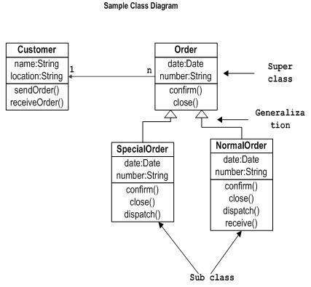

Slide 115
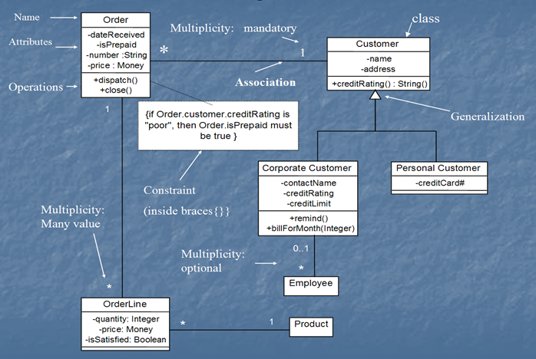

Slide 116
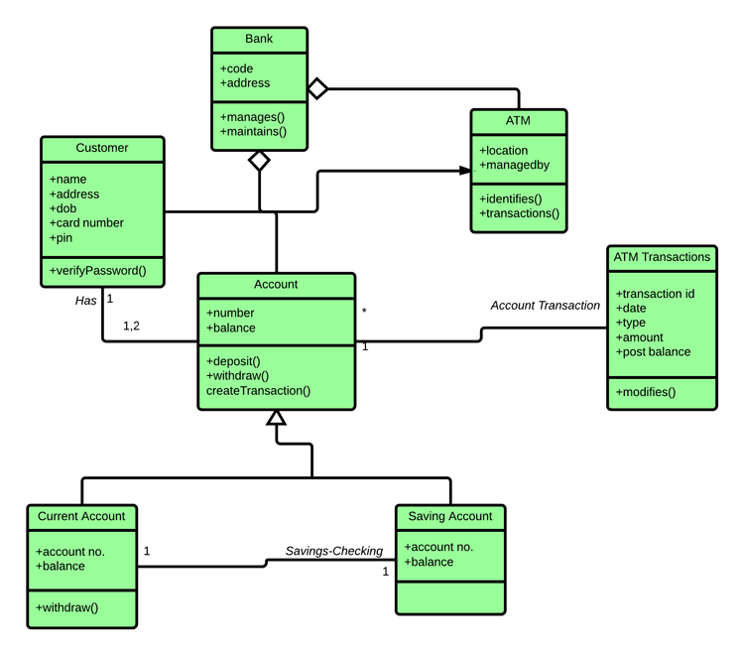
EXAMPLE

Slide 117
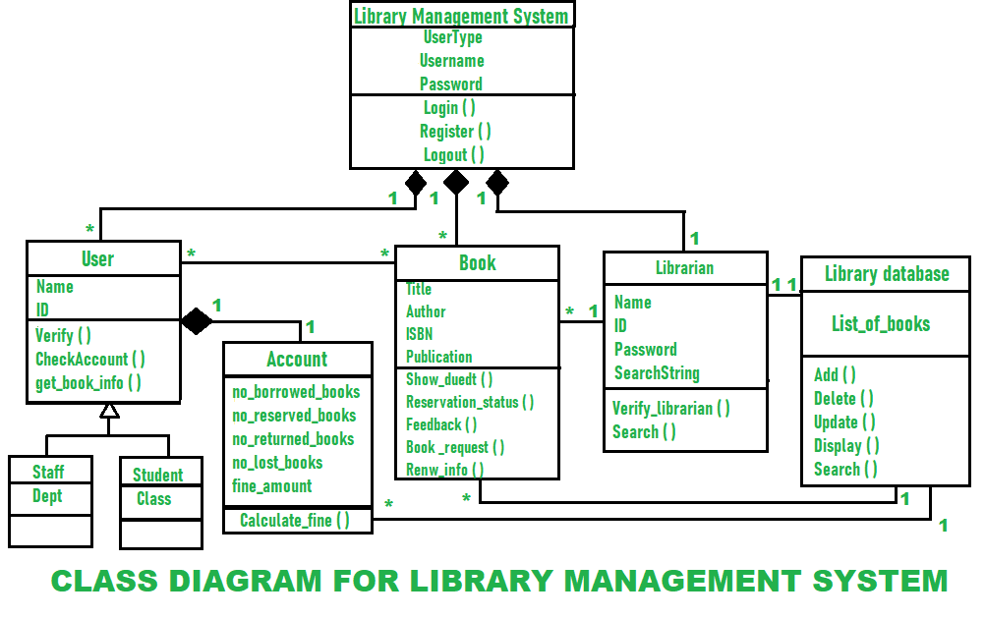

Slide 118
THANK YOU

